Slide 1

Building Hybrid Apps with AngularJS and Ionic

Slide 2





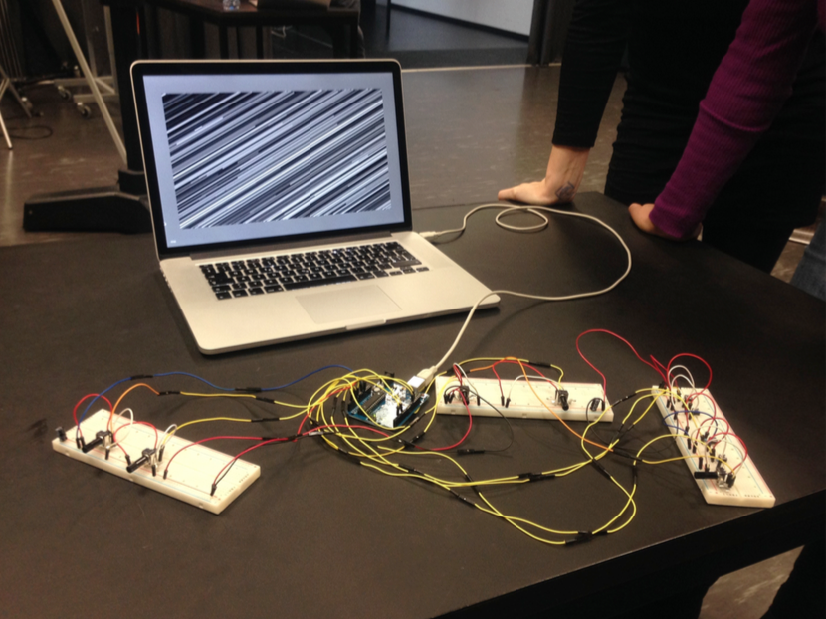
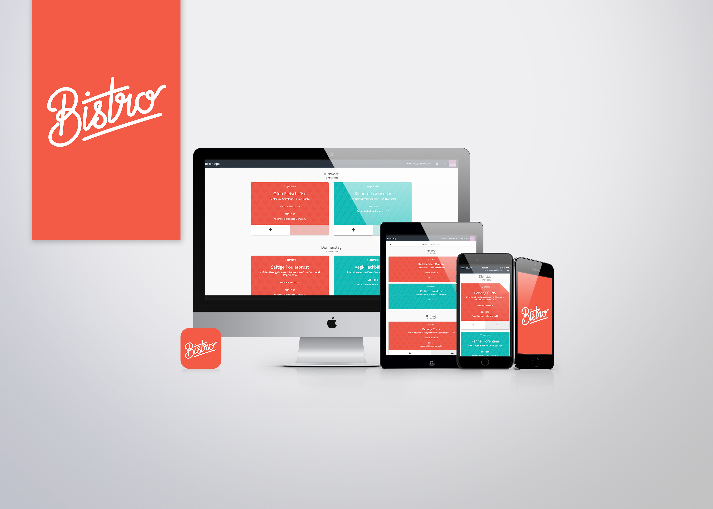

Roman Rast
What I do
Mobile App Dev
UX / Interaction Design
Frontend
Zühlke
Slides and stuff
https://github.com/romanrast/fhnwionic
Flipboard my Ionic magazin +180 followers
http://flip.it/q-lfz
Twitter
@romanrast
Contact
roman.rast@zuehlke.com
Notes:
FHNW / HGK (Hochschule für Gestaltung und Kunst)
Data analyst
Database SQL
C#
- Deutsch/CH
Installation geklappt?
USB Kabel dabei?
Wer hat einen Apple Dev account?
Wer hat schon hybrid entwickelt – Erfahrungen?
Erwartungen an den Kurs?
Folien auf Englisch damit wir sie im Web, Meetups, PGDay teilen können – open source

Slide 3




Use Web Technologies
Notes:
If you are a web developer you almost already are an Ionic app developer – welcome!

Slide 4

Ionic
HTML5 Framework for hybrid mobile apps
Build on AngularJS
Uses Cordova
First alpha in 2013, 1.0 Beta 2014, 1.0 2015
High performance
iOS > 7, Adnroid > 4.1
Open source
Many Frameworks built-in
AngualrJS, Cordova, Gulp, Sass, NodeJS, Bower
Custom directives/components -> <ion-list>
Drifty Co
Notes:
Started with Codiqa a JQueryMobile site builder
Max lnych
In 2015 Ionic developers reportedly created over 1.3M apps with the SDK
For Android, Ionic supports Android 4.1 and up. For iOS, Ionic supports iOS 7 and up
native hardware acceleration
Bower (for installing components and package manager) (NodeJS for handling installations)
Directives which help make your apps look and feel more like native apps

Slide 5
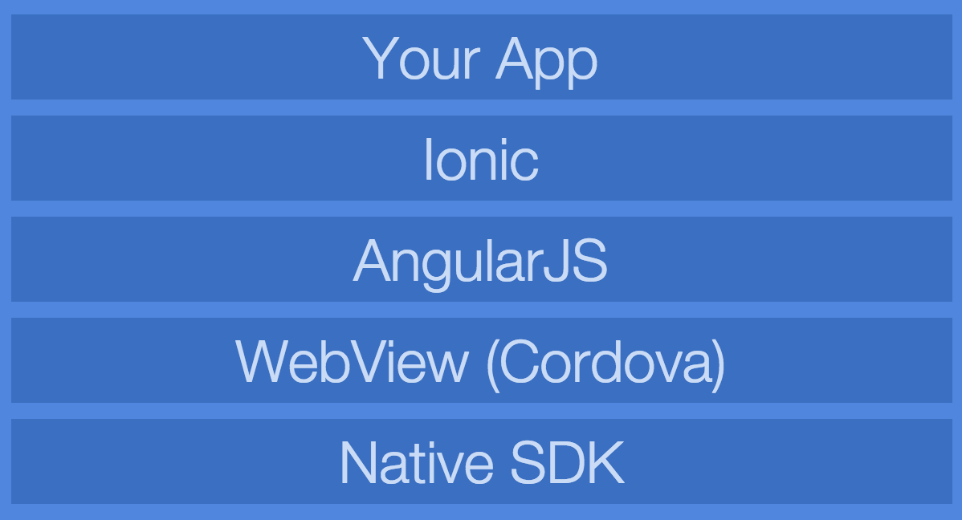
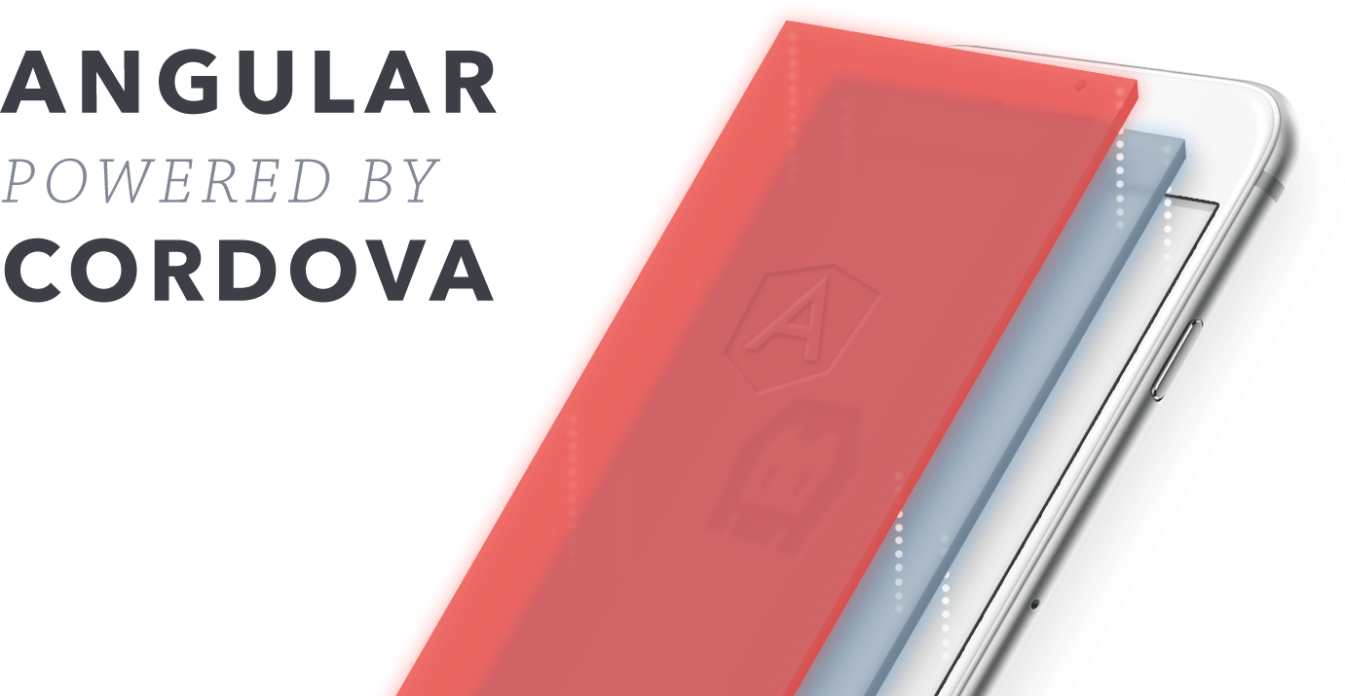
Architecture
Notes:
Native SDK (xcode, android sdk)
Explain WebView (browser on you mobile without url bar and all the stuff – just the view)

Slide 6


Wraps app into a native app
App uses WebView (browser of the phone without url bar and other stuff)
Offers APIs to access camera, contacts, accelerometer finger print scanner etc.
Develop a single code base for iOS and Android...
PhoneGap/Cordova - Adobe
Notes:
- Cordova street in vancouver
- PhoneGap is a distribution of Apache Cordova. You can think of Apache Cordova as the engine that powers PhoneGap, similar to how WebKit is the engine that powers Chrome or Safari. Over time, the PhoneGap distribution may contain additional tools and that‘s why they differ in command But they do same thing. (PhoneGap Build, support for Adobe tools, different command line commands)

Slide 7
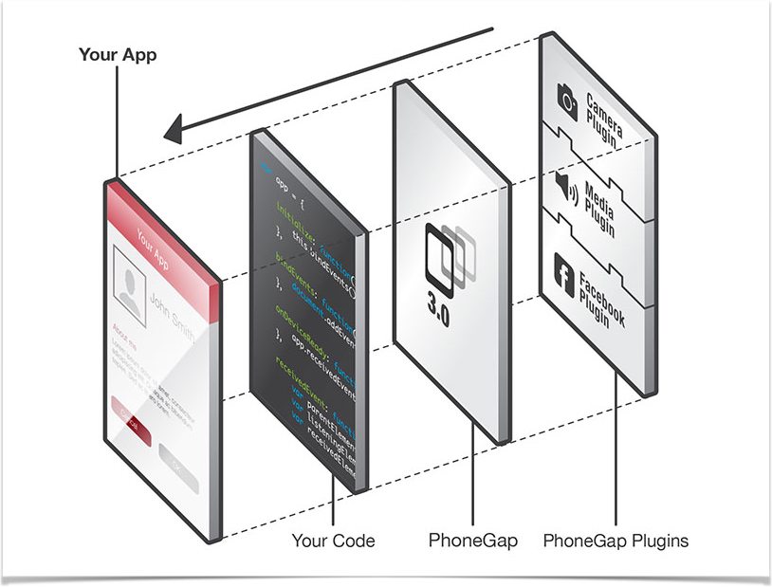

Slide 8
Pro | Cons
Pro | Cons
Open-source and free | Rendering complex UI can be slow
AngularJS, HTML, CSS | Not the best choice for graphic intense UI
SASS support | Android can be a hard to show same perfomance on mid-range phones
Offers large number of 3rd party resources, plugins, thems, starter apps (ngCordova Plugins, ionic market, ionicons, ionic.io)
Great forum
One code base for iOS and Android (almost)
Notes:
- Run on multiple devices with one code base is a huge advantage vs native (learn swift and xcode and java for android)
Can also be used for websites but not recomended yet. We made an app for a bank that was using Ionic just as a webapp
Use your knowledge as a web dev and be an app developer and a web developer

Slide 9
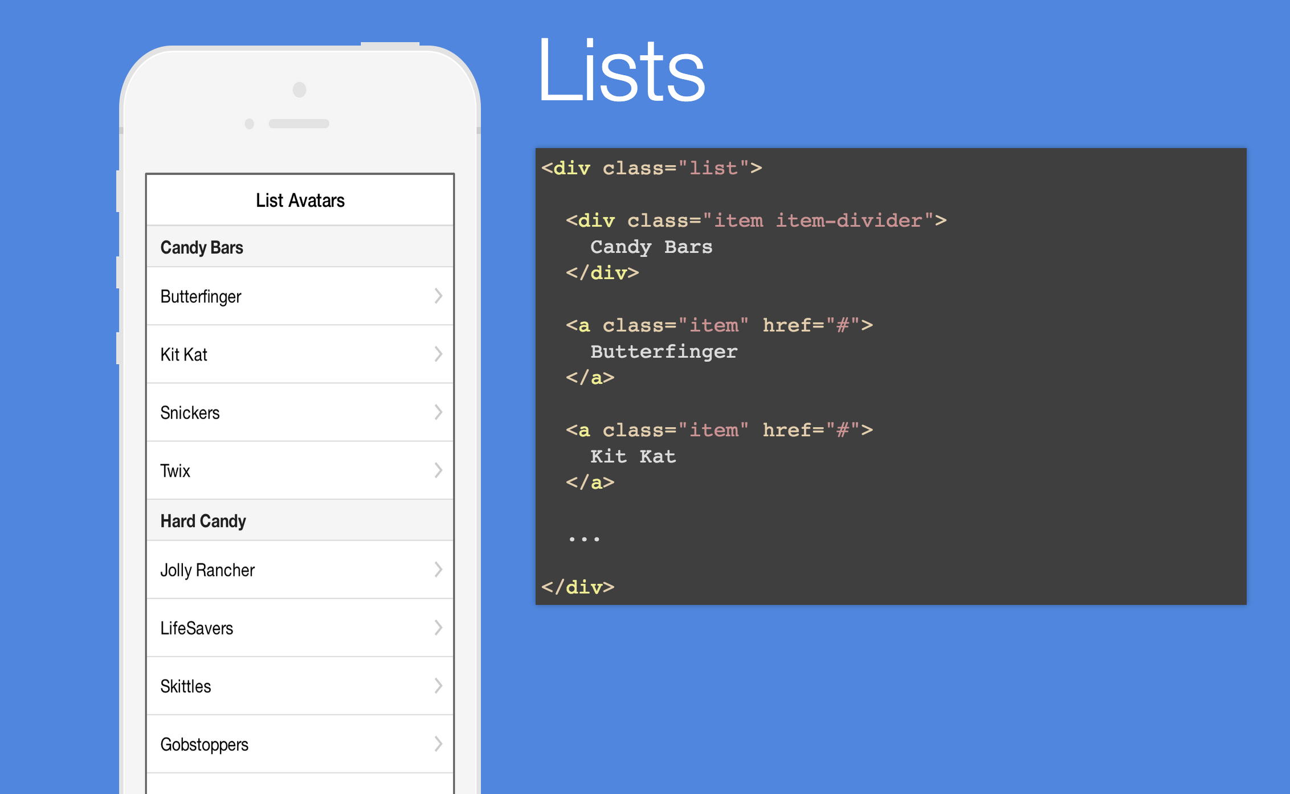
Notes:
Ionic offers classes which brings you the native look

Slide 10
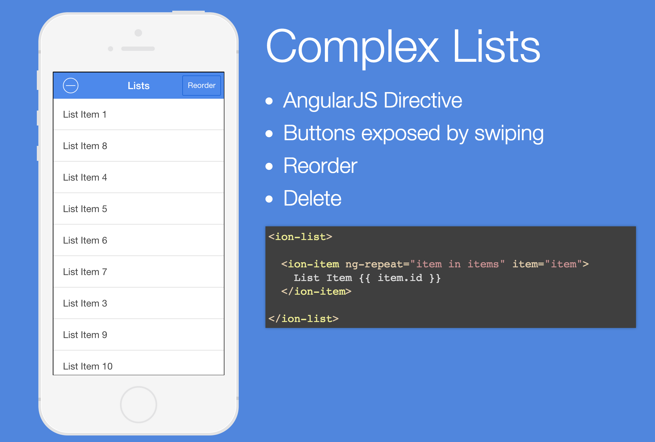
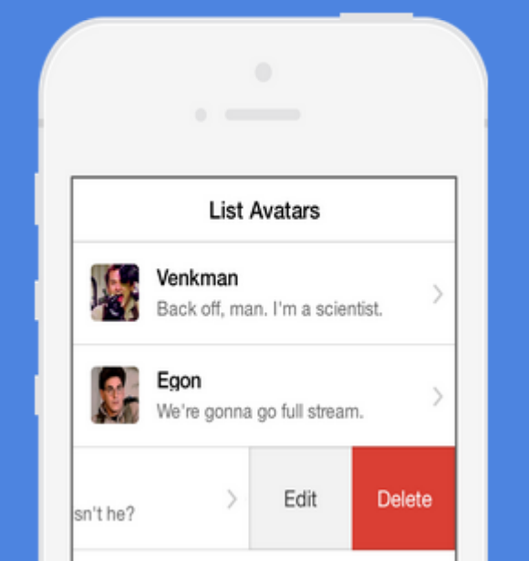
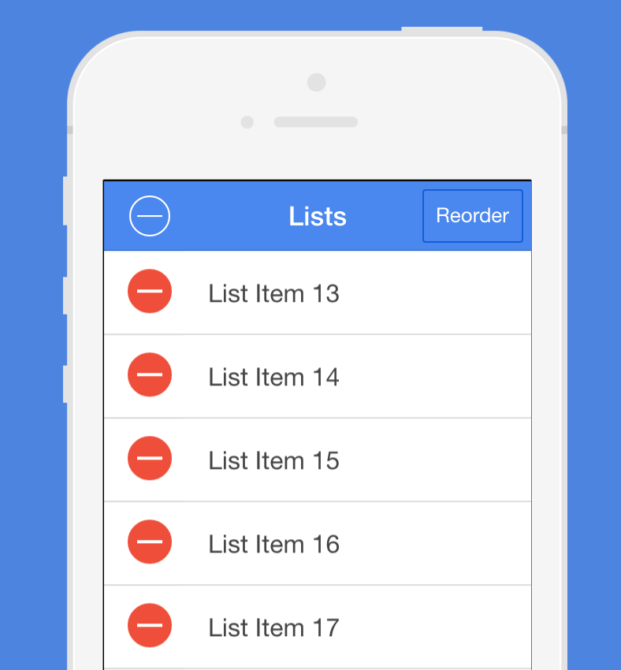
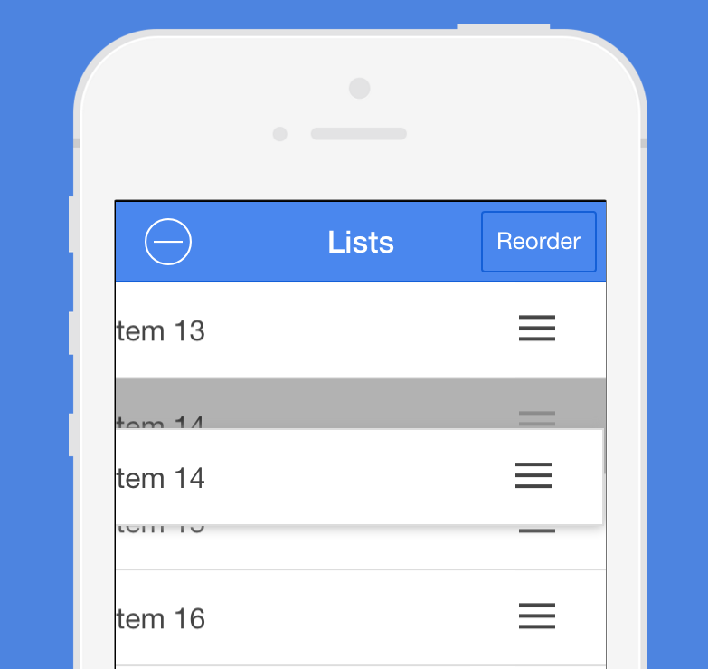
Notes:
Ionic comes with lots of directives (basically HTML extensions)
Show EXAMPLE

Slide 11
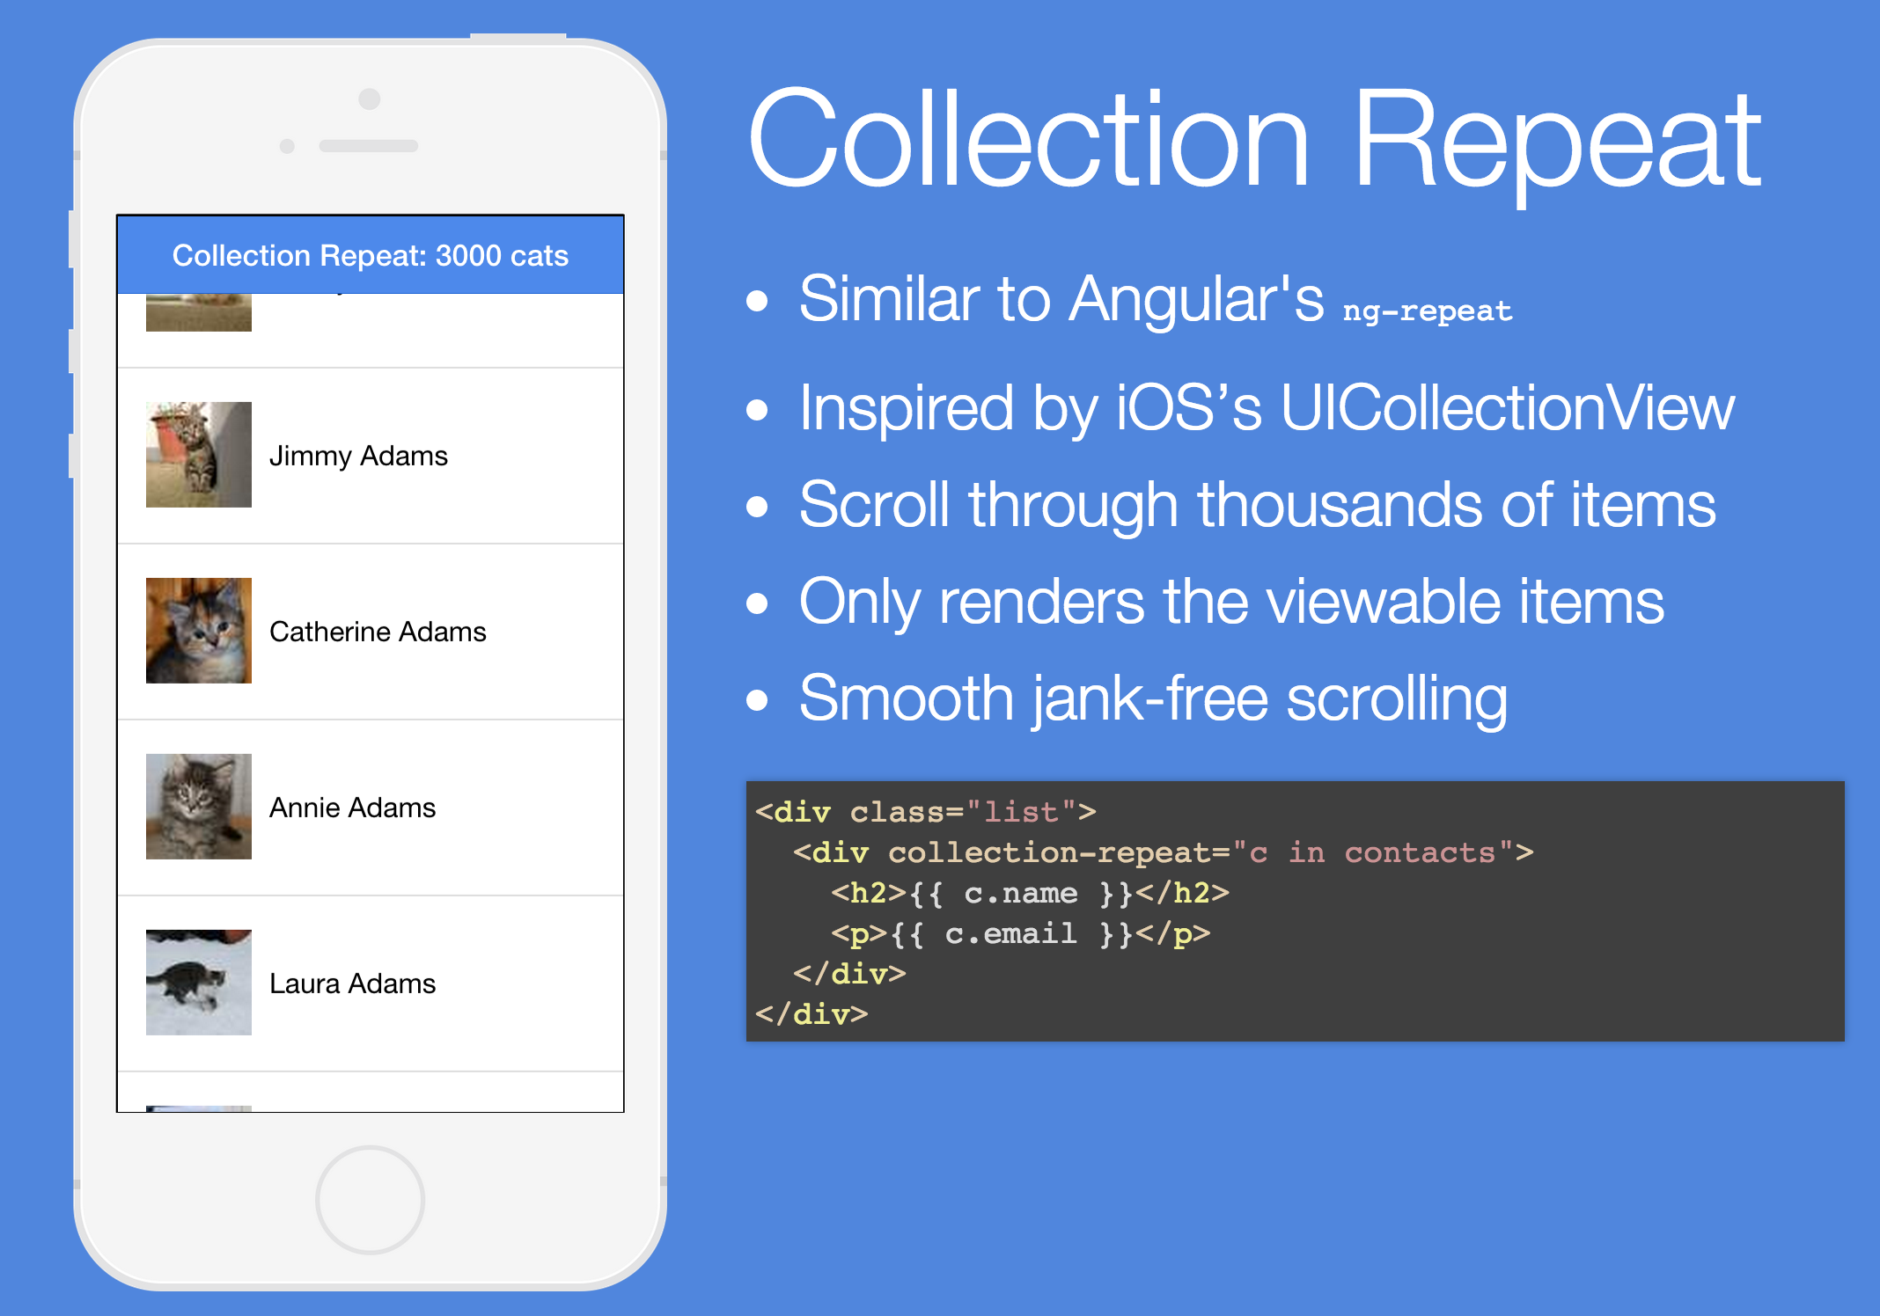

Slide 12
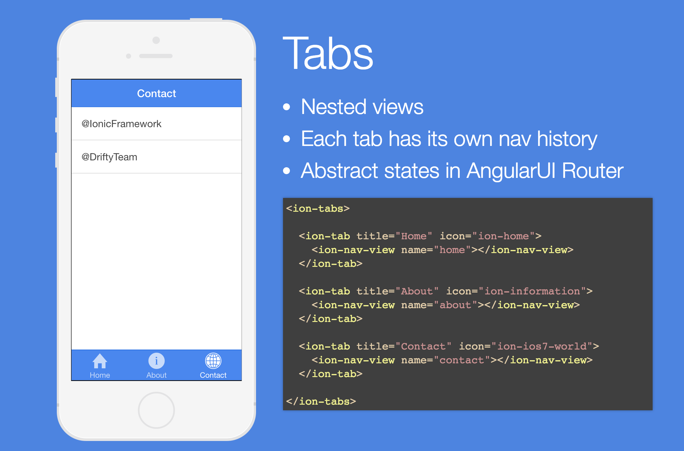
Tabs
Notes:
Also show badges and count for tabs
<ion-tab title="Chats" badge="2" badge-style="badge-assertive" icon-off="ion-ios-chatboxes-outline" icon-on="ion-ios-chatboxes" href="#/tab/chats"> <ion-nav-view name="tab-chats"></ion-nav-view> </ion-tab>

Slide 13
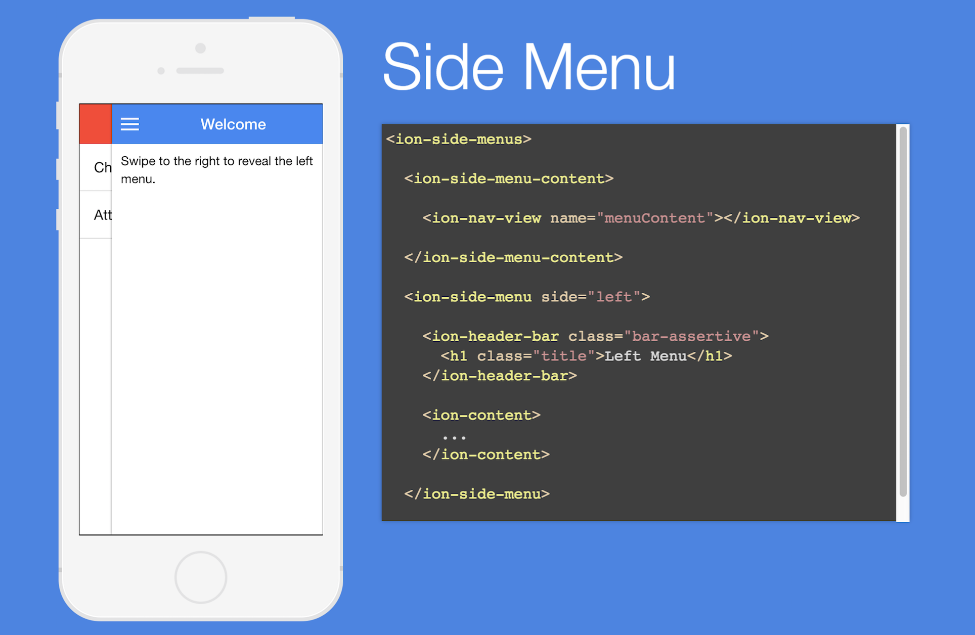
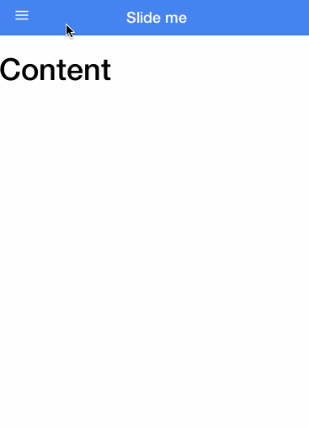
Side Menu

Slide 14
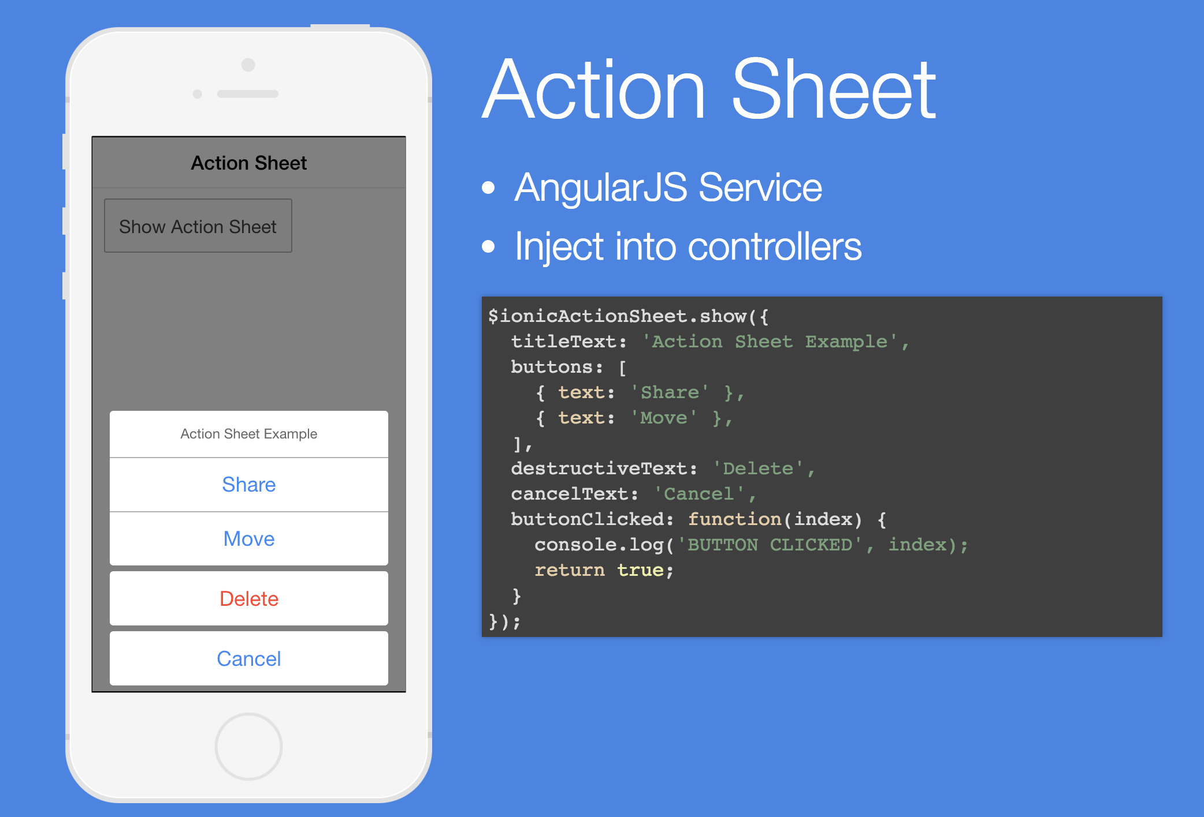

Action Sheet

Slide 15
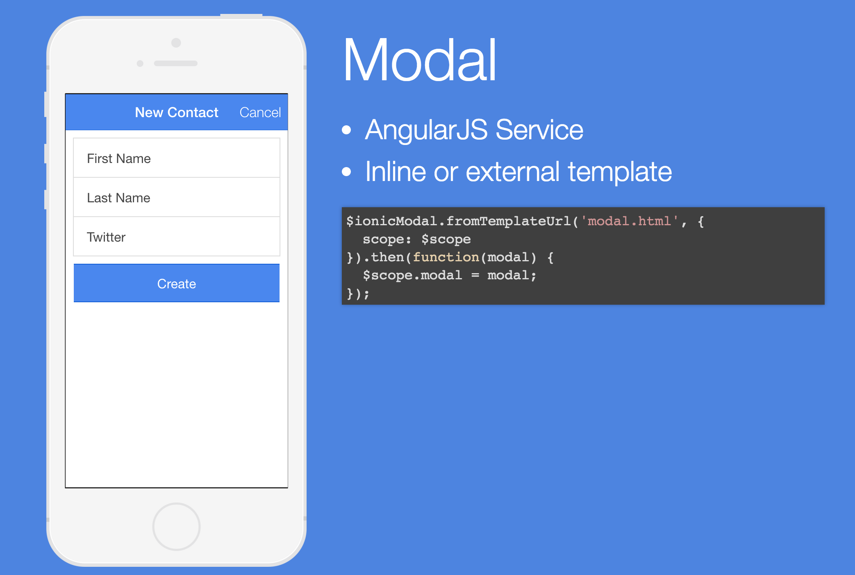
Modal
Notes:
Modal for showing images, login etc..

Slide 16
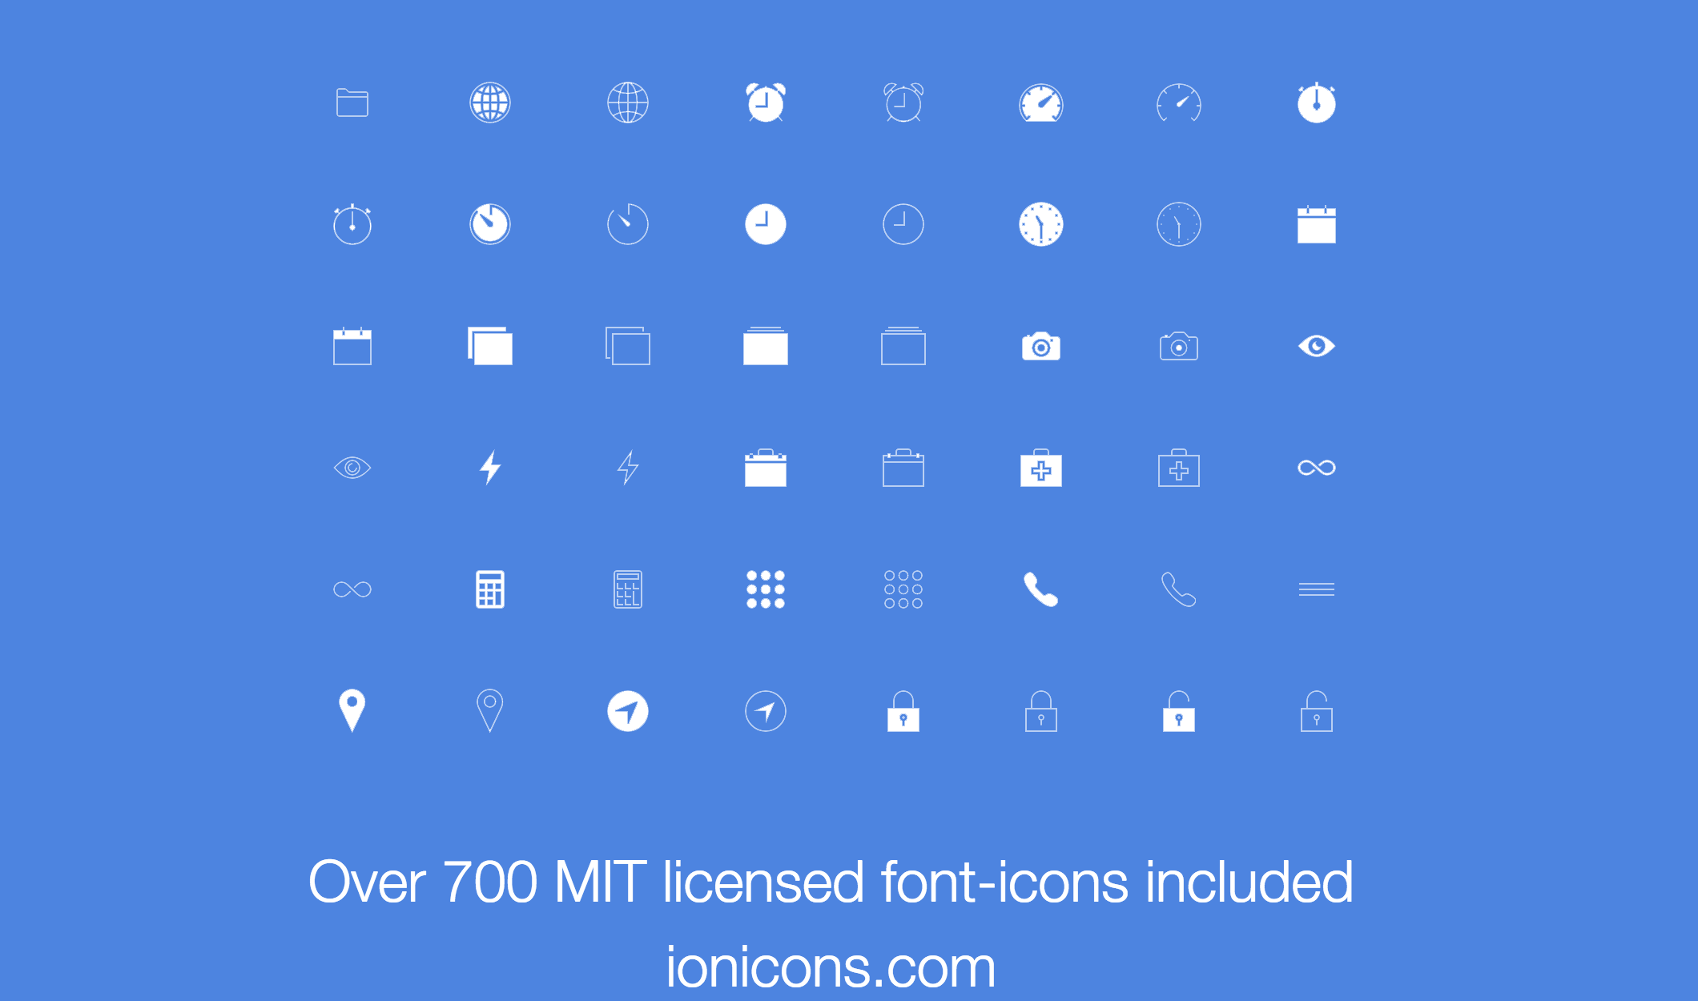
Ionicons

Slide 17
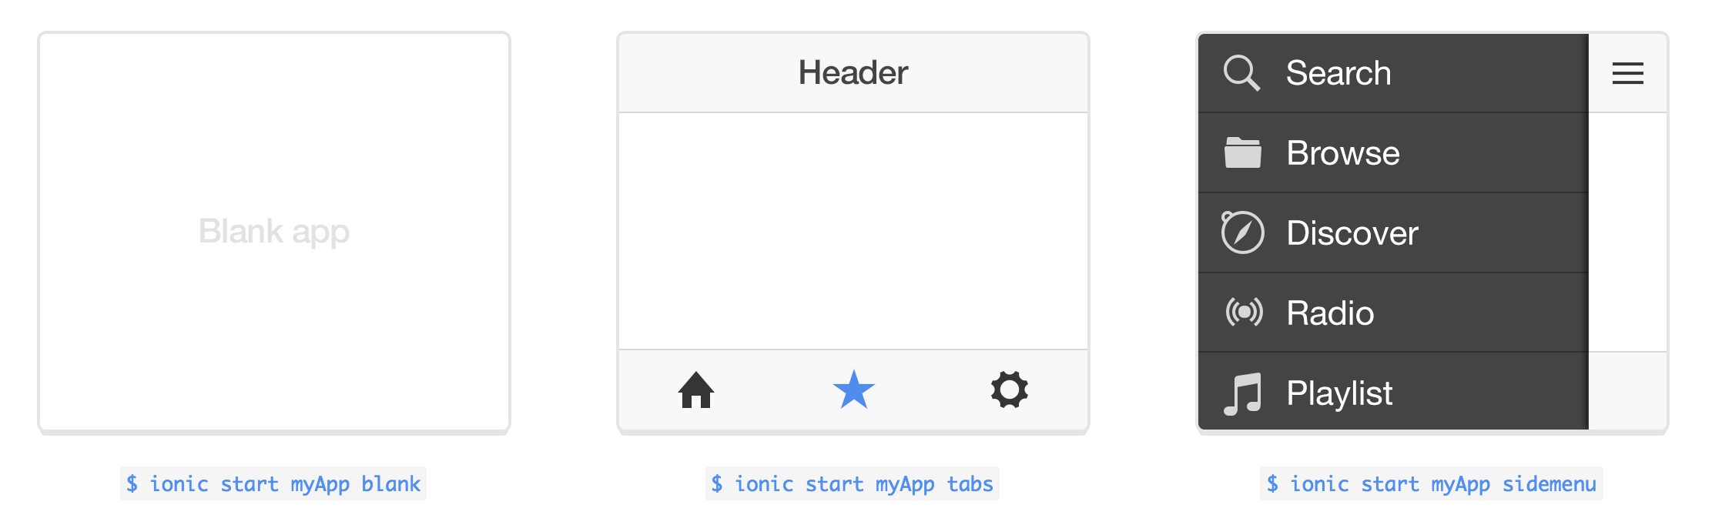
Installation
Install Node.js (https://nodejs.org/)
$ npm install -g cordova ionic
$ sudo ionic start myApp tabs
$ cd myApp
(change access right if necessary on mac)
$ sudo ionic platform add ios | android
$ sudo ionic build ios
$ sudo ionic setup sass
$ sudo ionic serve
$ sudo ionic run ios | ionic run android (when deive is pluged in)
Keep xcode and iOS versions always up to date!
Notes:
(Android Entwickler modus aktivieren)- einstellungen, über das telefon, android-version antippen bis meldung kommt. Dann bei Entwickleroptionen – USB-Debugging aktivieren.

Slide 18
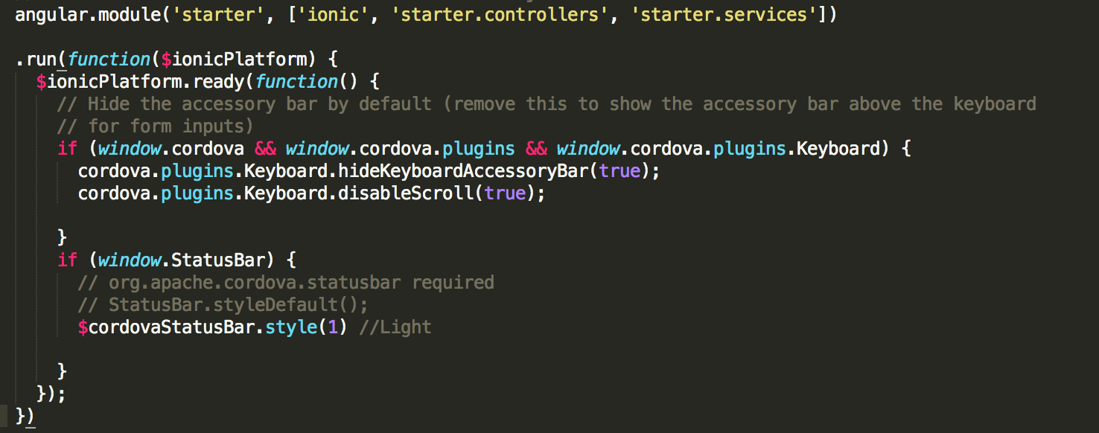
Plugins
Out of the box
cordova-plugin-splashscreen
cordova-plugin-statusbar
ionic-plugin-keyboard
More on ngCordova
http://ngcordova.com/
Notes:
We will use satusbar plugin to change the bar color on ios
And
Geolocation plugin to get some weather data
Config for splash screen on android

Slide 19
CLI
$ cd myApp
# Add iOS and Android platform for cordova
$ ionic platform add ios | $ ionic platform add android
# Build Debug version
$ ionic build ios | $ionic build android
# Build Prod version
$ ionic build ios --release
# Run in Browser
$ ionic serve
$ ionic serve --lab
# Run in emulator
$ ionic emulate ios
# Run on real device if connected
$ ionic run ios
$ ionic run android
$ ionic package debug android (debug or release | android or ios)
Notes:
Live reload

Slide 20
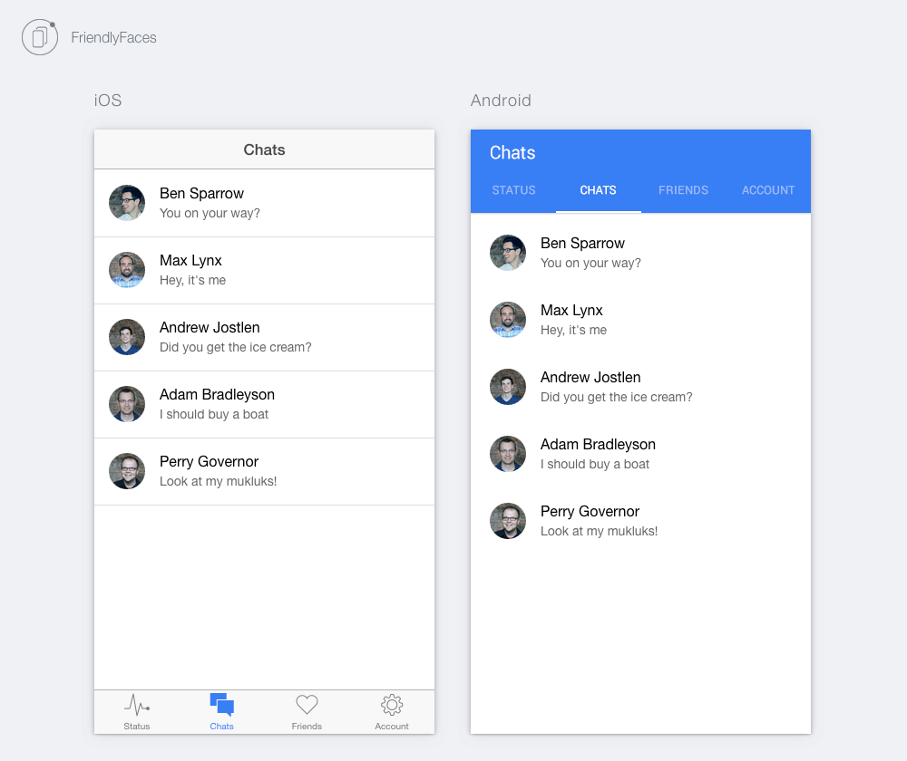
iOS vs Android
iOS swipe back
Android nav on top
Notes:
Ionic takes care of UI for iOS and Android
Also material design will work
Ionic serve --lab

Slide 21
Prepare Your Device
Android - activate developer mode
Settings/about phone tip on Build number until message appears
Go back to Settings, then Developer options and check USB debugging
iPhone
Just plug in an press play in xcode – yay!
Notes:
(Android Entwickler modus aktivieren)- einstellungen, über das telefon, android-version antippen bis meldung kommt. Dann bei Entwickleroptionen – USB-Debugging aktivieren.

Slide 22
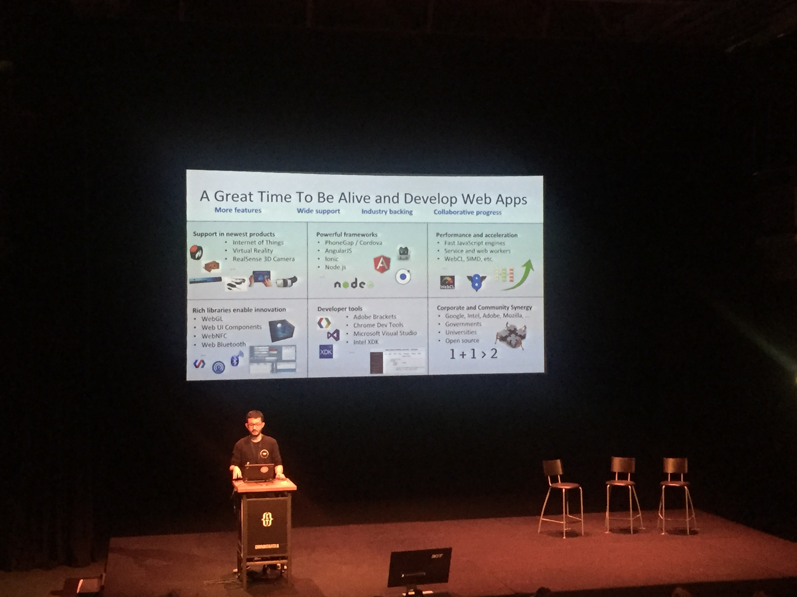
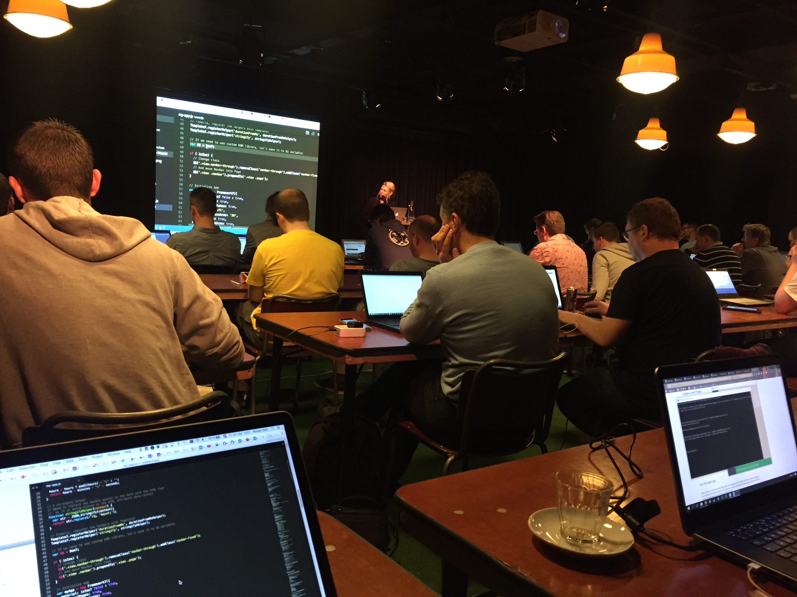


PhoneGap Day

Slide 23
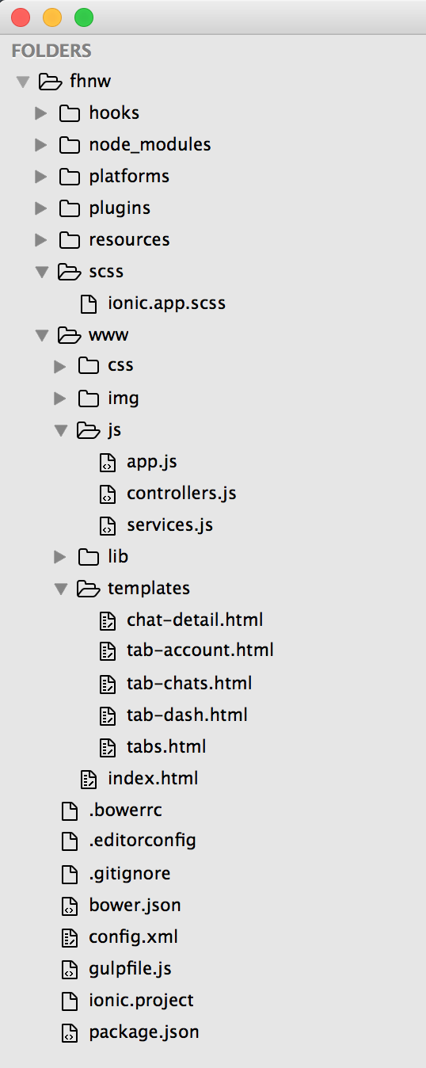
App Structure
Hooks
Plugins
www
bowerrc
gitignore
config.xml
gulpfile.js
package.json
css
img
js
scss
Notes:
Folder Structure
Hooks – scripts to customize cordova commands. Seldom need to use
Plugins folder has Ionic extensions (keyboard, etc.) not working a lot in here. Extensions will be installed here. Use git and make sure you have git installed.
www
bowerrc – ionic uses this to install some components
gitignore – to ignore files if you use git for team project etc.
config.xml - cordova setup document not much here either
gulpfile.js - controls the automation for ionic to reload the browser as well as do things like process files ex change .scss ending to .sass
package.json – often appears with node projects. has copies of modules that gulp or node need to perform their duties
css – your css If you don’t use sass
img – folder for your images
js – all of your javascript
app.js main application file that loads angularjs and its controllers and directives.
Controllers – javascript for part of the application / functions etc.
Services to make call to api etc.
Lib – folder for your libraries
Templates – place for your views html sites
Index.html – starting point of the single page application
scss
if ionic is setup with sass (ionic setup sass)
override ionic defaults

Slide 24
App Structure
Work in the www folder on the root of your app
The code will be copied down to platforms/ios and android
For iOS go to platforms/ios/xxx.xcodeproj to run app on device or Simulator

Slide 25
Debugging & Testing
Use Google CHROME!
Developer Tools

Slide 26
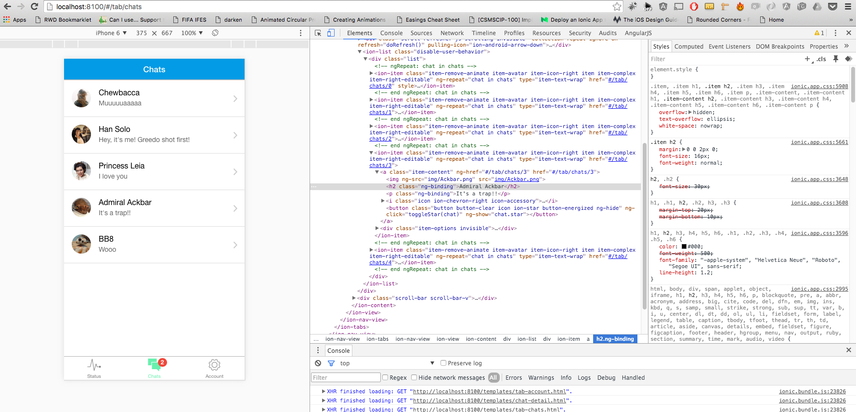

Slide 27
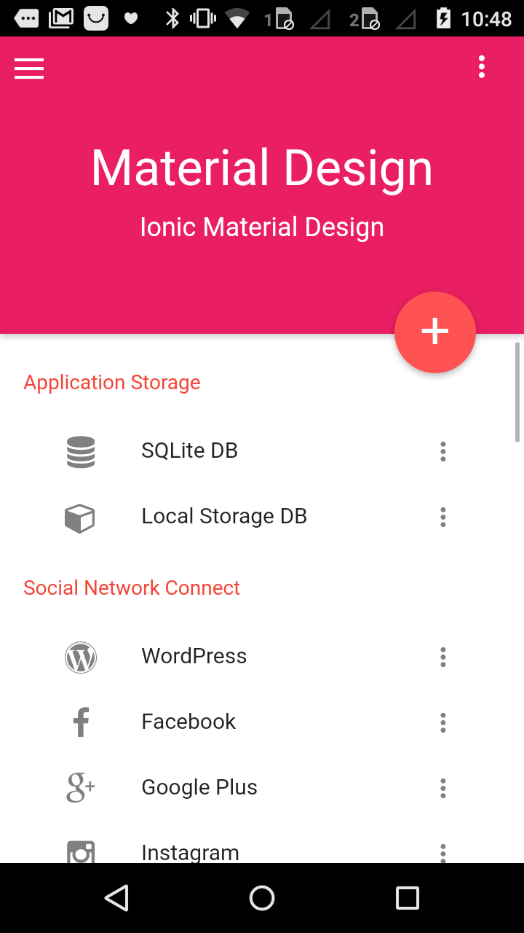
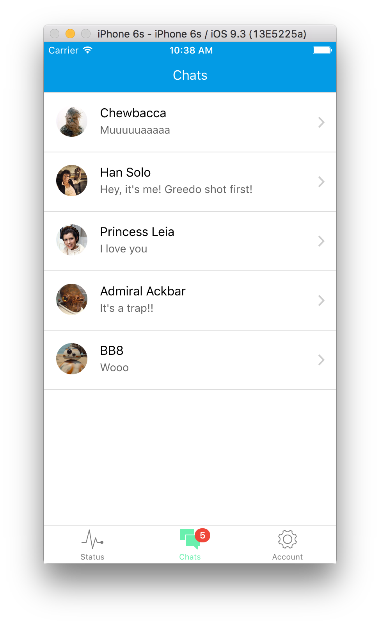
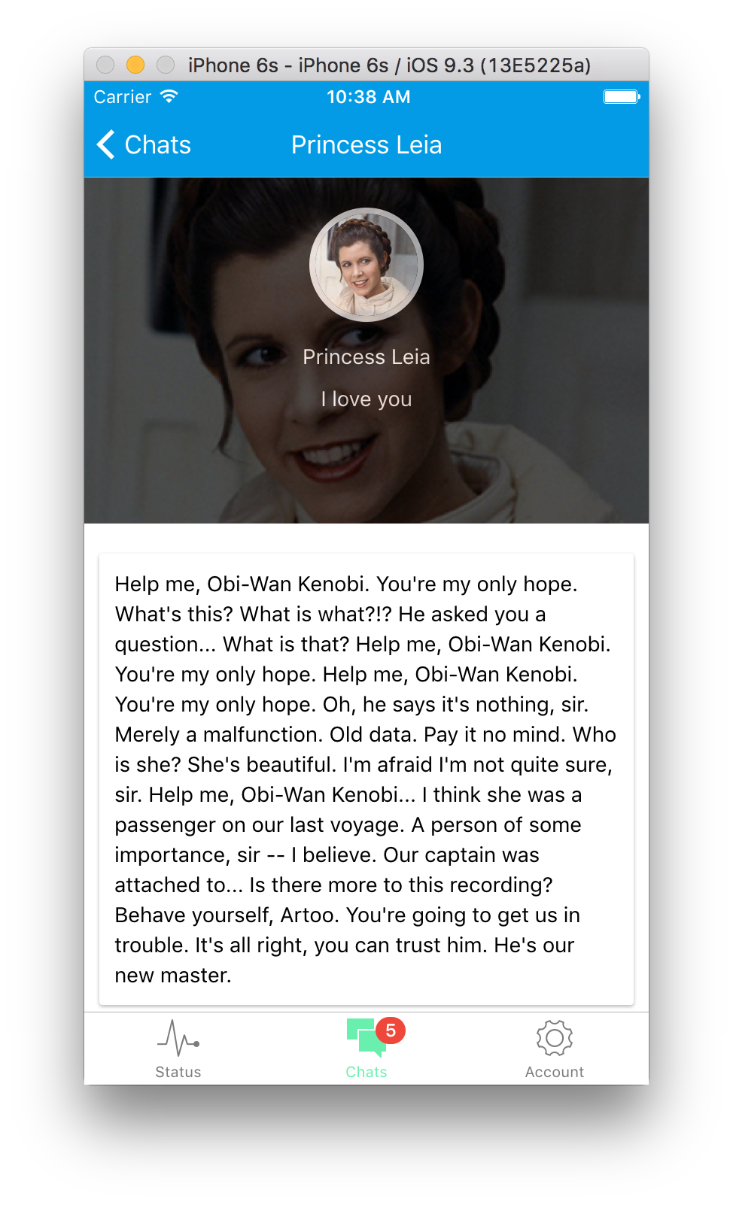
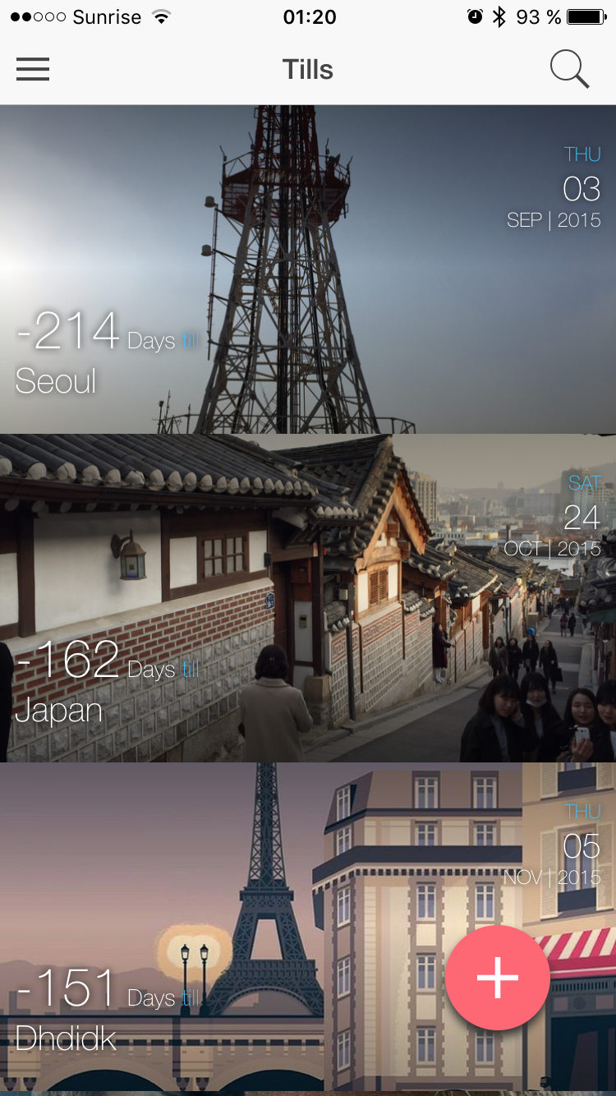
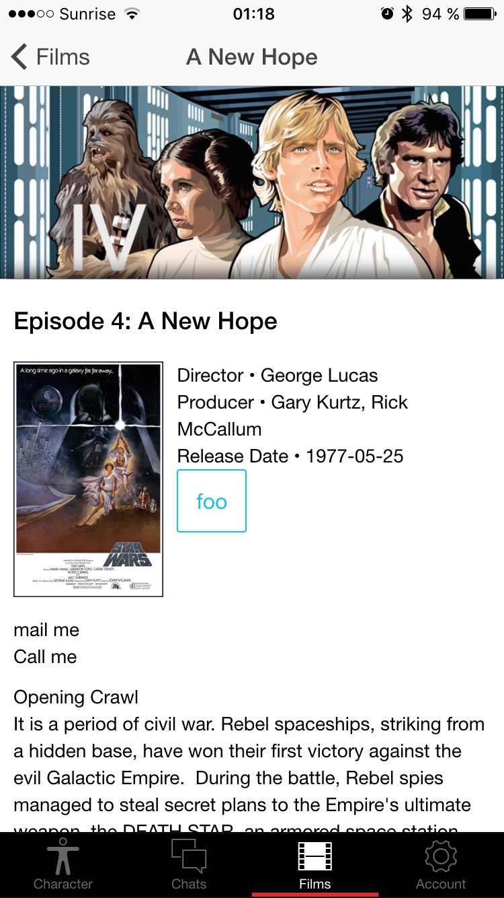
Demo Time

Slide 28
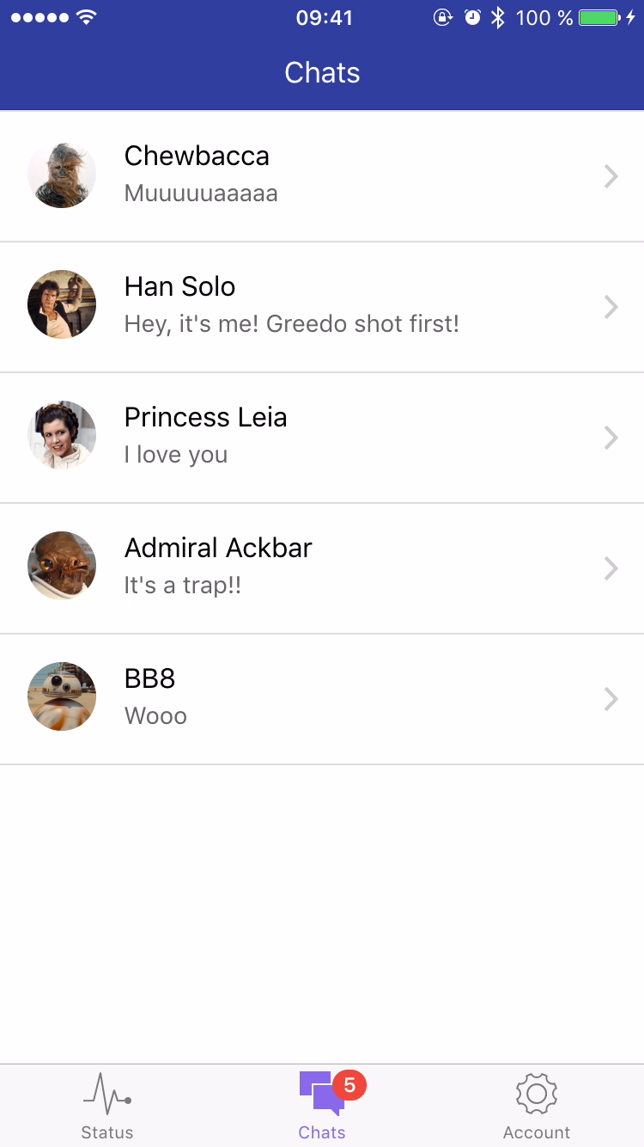
Demo Time

Slide 29
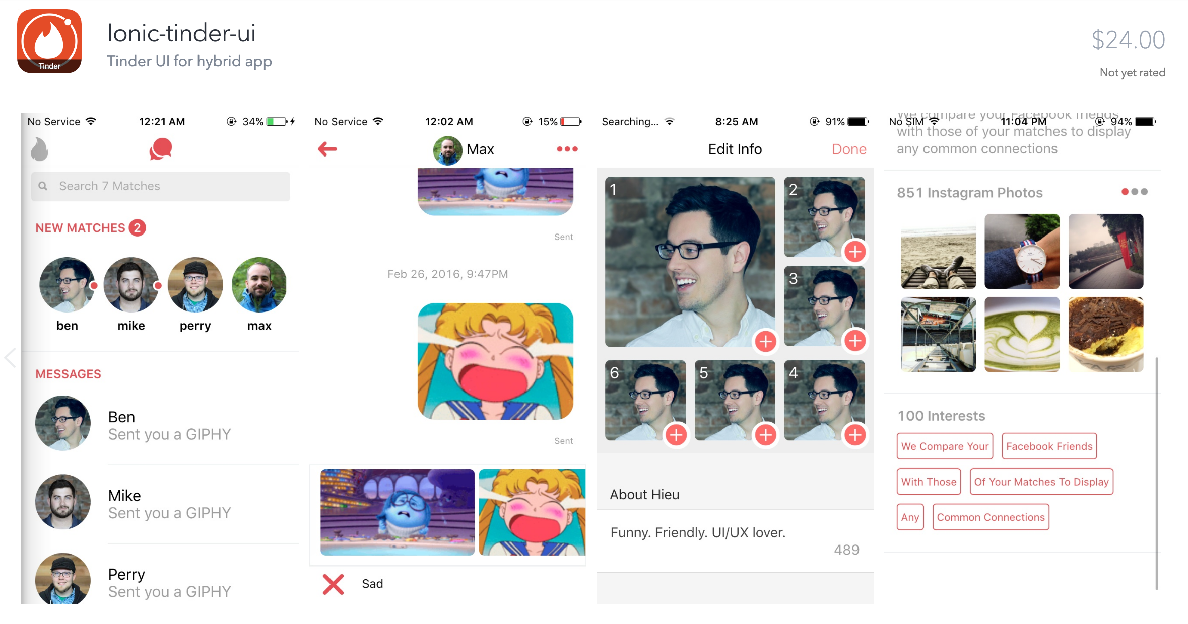
Tinder with Ionic (548a574d)
Notes:
Use ionic view app to test with ID: 548a574d
https://market.ionic.io/themes/ionic-tinder-ui

Slide 30
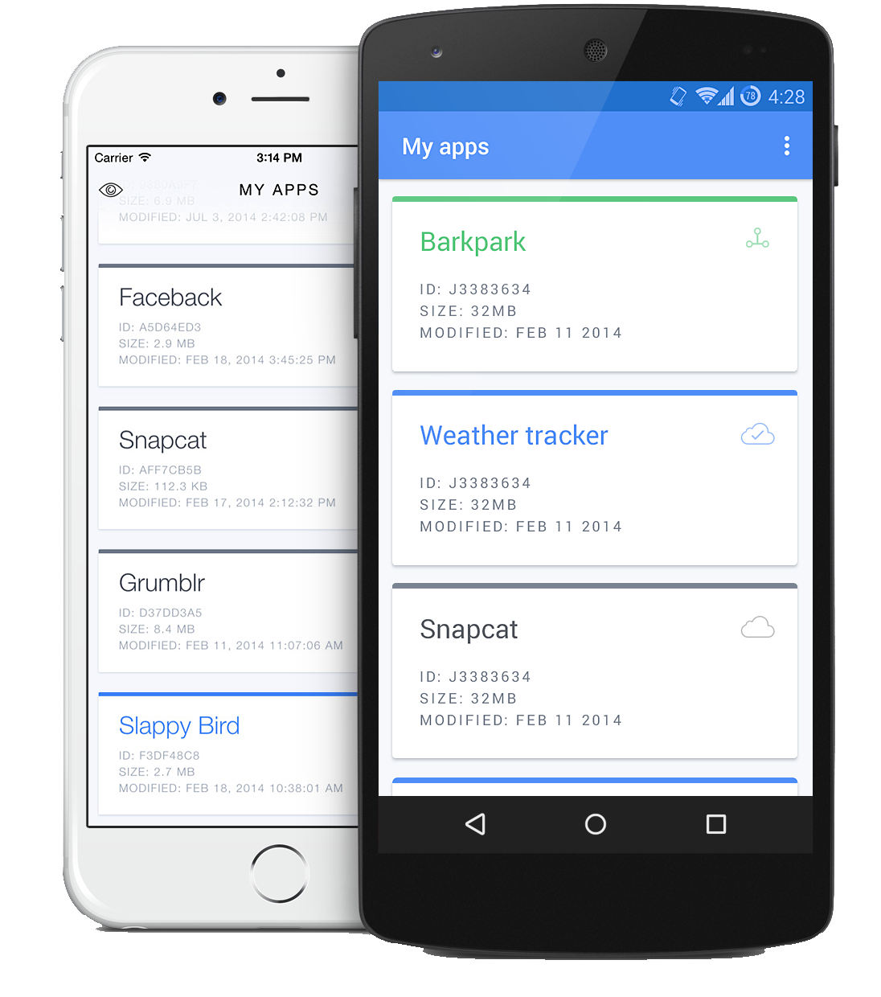
Ionic View
Send your app to users for testing
$ ionic login
$ ionic upload
$ ionic share EMAIL
Or share the ID
E609BED6
Notes:
iOS exit with 3 finger swipe down
Android exit by navigating back

Slide 31

Coding Time
Copy the code on Google docs https://goo.gl/E4UFs3

Slide 32
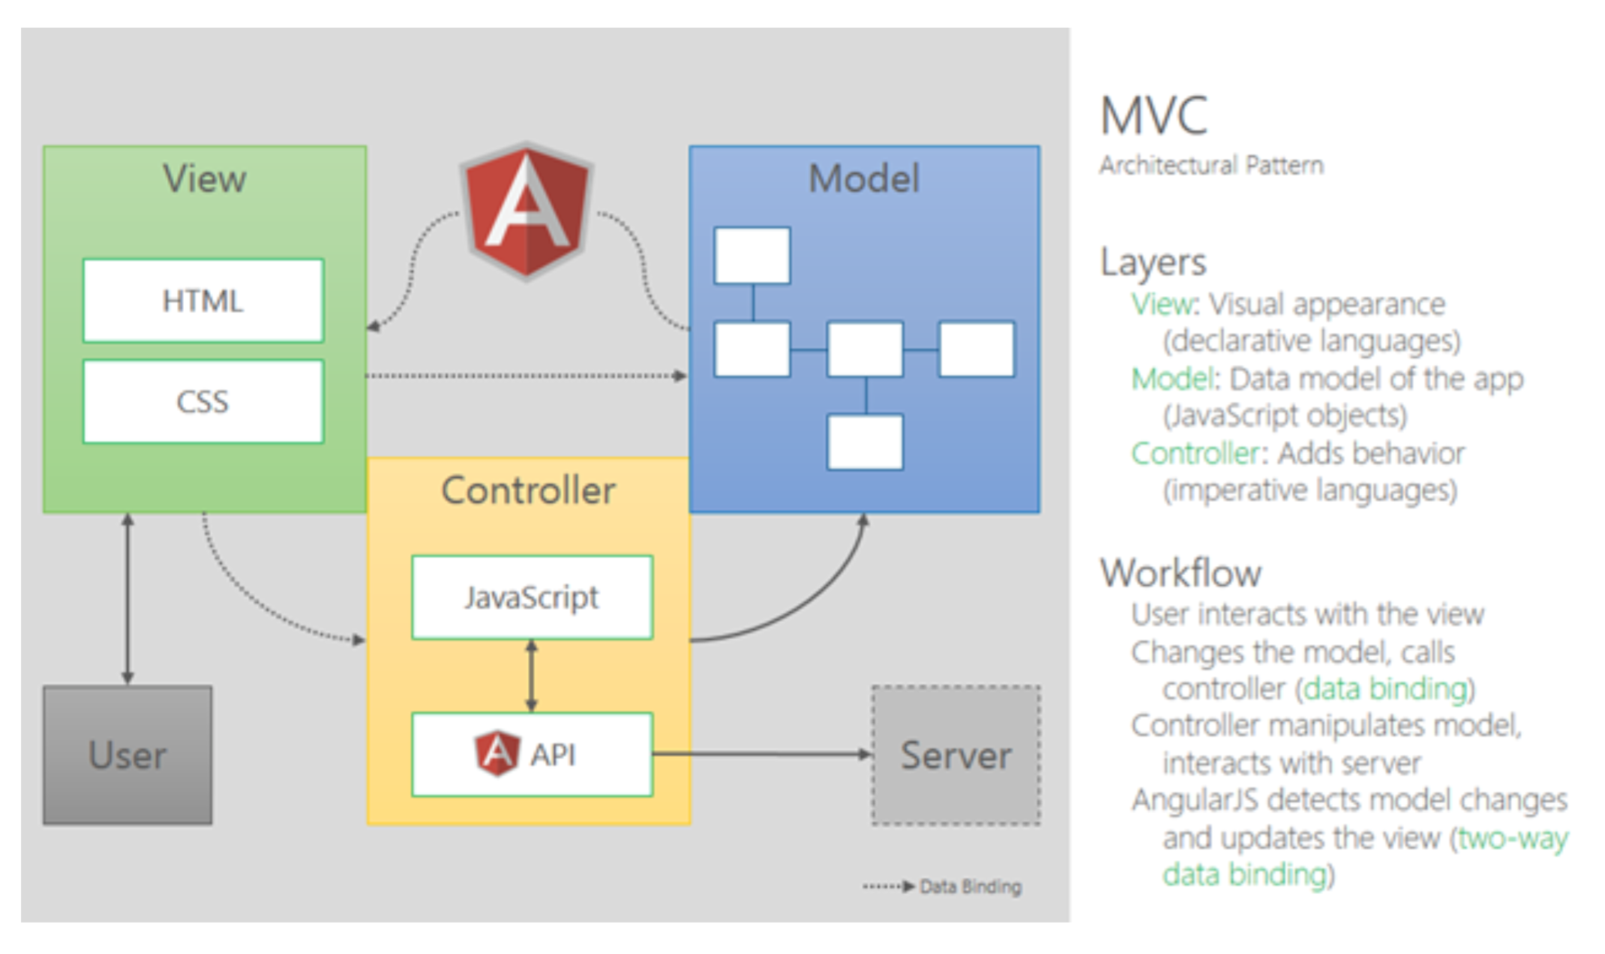
MVC

Slide 33
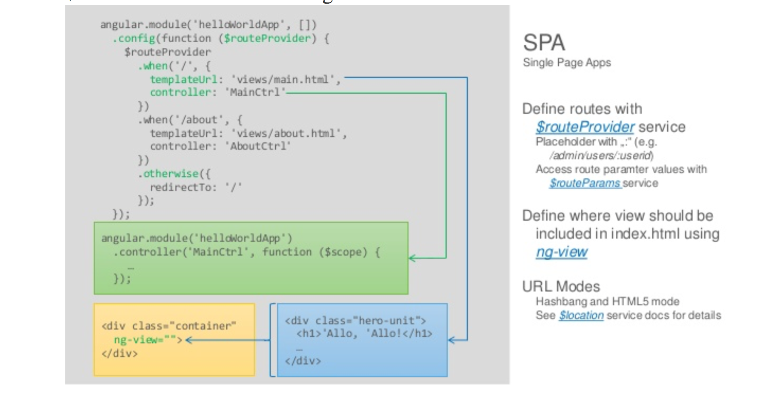
SPA (Single Page Application)

Slide 34
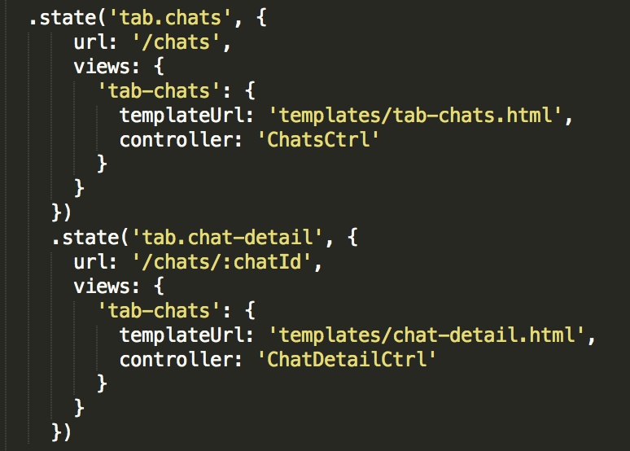
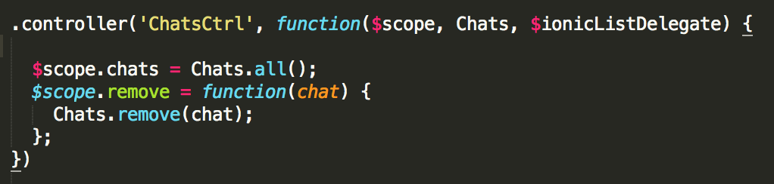
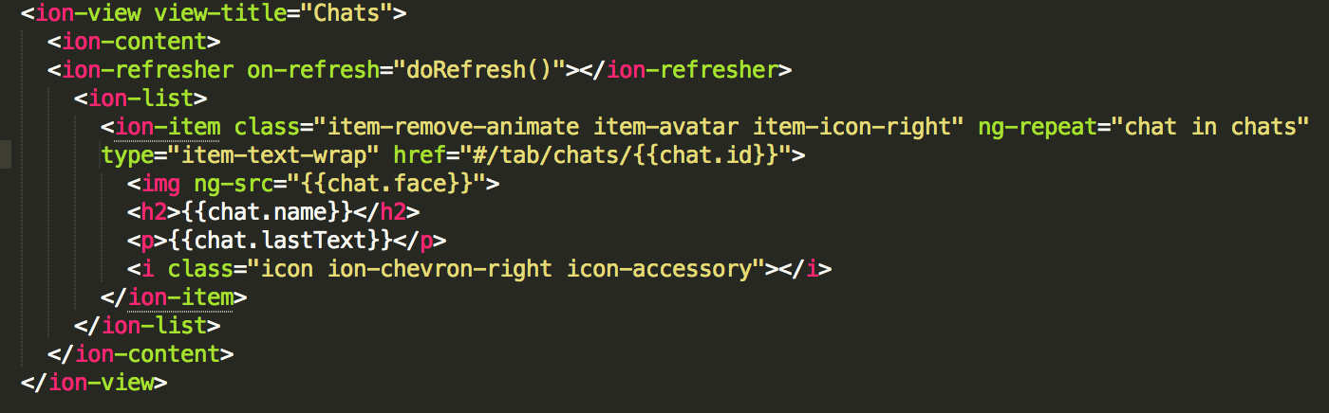
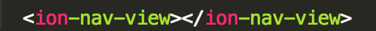
MVC
app.js
controller.js
tab-chats.html
index.html
Notes:
App.js with routing
Ion-view will be injected into ion-nav-view
Controllers with functions for logic

Slide 35
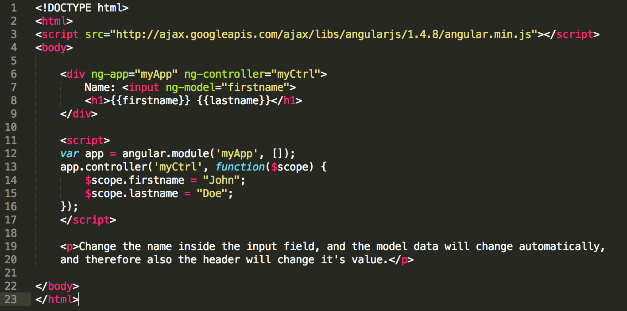
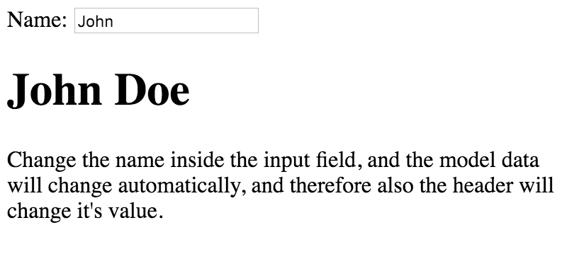
AgnularJS
CONTROLLER
$scope.firstname = “John“;
View Tepmlate
{{firstname}}
Notes:
http://campus.codeschool.com/courses/shaping-up-with-angular-js/intro
<!DOCTYPE html><html><script src="http://ajax.googleapis.com/ajax/libs/angularjs/1.4.8/angular.min.js"></script><body><div ng-app="myApp" ng-controller="myCtrl"> Name: <input ng-model="firstname"> <h1>{{firstname}} {{lastname}}</h1></div><script>var app = angular.module('myApp', []);app.controller('myCtrl', function($scope) { $scope.firstname = "Johns"; $scope.lastname = "Doe"; });</script><p>Change the name inside the input field, and the model data will change automatically, and therefore also the header will change it's value.</p></body></html>

Slide 36
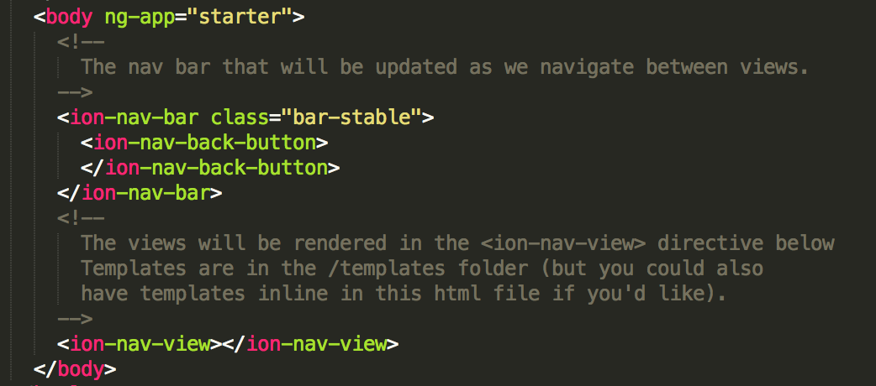
Module
angular.module is a global place for creating, registering and retrieving Angular modules
Notes:
Module is where we write pieces of our angular application.

Slide 37
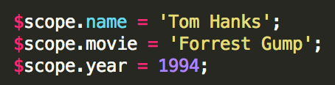
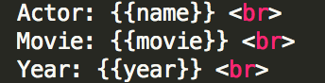
Controllers
Where you define values and functions that make up the behavior of your app
And helps you to get your data onto your view
$scope
A javascript object and is the glue between our controller and our view
It‘s how the data is made available to both, the controller and our view
Controller
View
Notes:
Helps us to get data onto our view. It’s where we define values and functions that make up the behavior of our angular app.
$scope is a javascript object and is the glue between our controller and our view. It’s how the date is made available to both the controller and our view. The function needs $scope as its argument.
Expressions
{{5 + 3}} will be compiled to 8 on your view

Slide 38
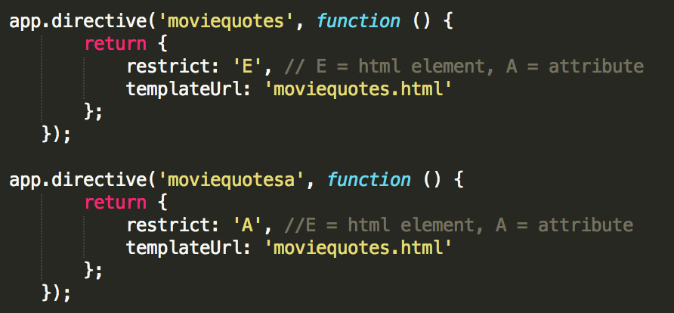
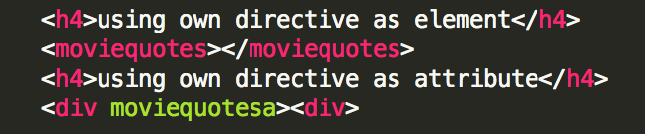
Directives
Creat your own html elements or attributes. -> Extend html elements
Angular directives beginn with a prefix of ng-...
ng-repeat repeats html elements once for each item in a collection/array
restrict E for html element | restrict A for html attribute
app.js
View.html
Notes:
It’s an extension of an html element.
Angular directives beginn with a prefix of ng-
ng-repeat -> repeats html elements once for each item in a collection/array

Slide 39
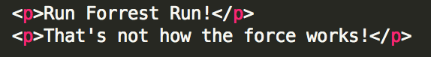
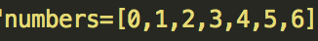
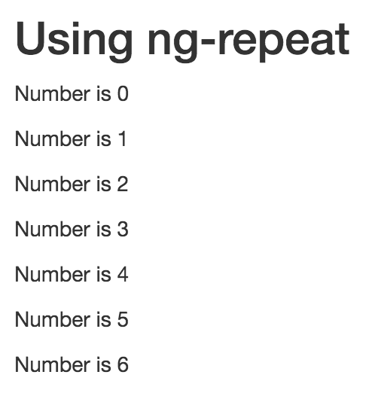
Directives examples
ng-include includes other templates into your view
overview.html
moviequotes.html
ng-repeat loop through an array and display each object

Slide 40
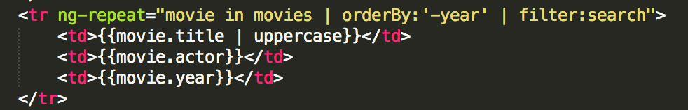
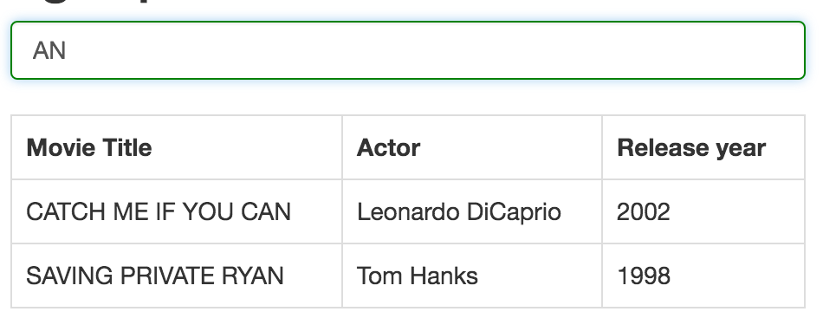
Filters
Us | to add a filter

Slide 41
MVC
View = Templates (chats.html)
www/templates/...
Controllers = angular.module('starter.controllers', []).controller('DashCtrl', function($scope) {})
www/js/controllers.js
Model = best in services.js, call it with REST and read/persist in db
www/js/services.js
Notes:
Model = Data in the application
View = Template
Controller = Javascript that ties the model to the view

Slide 42

Coding your App
Copy the code on Google docs https://goo.gl/E4UFs3

Slide 43

ngCordova

Slide 44
Add plugins
Use ngCordova plugins (http://ngcordova.com)
Install
$ bower install ngCordova (in root of app)
Then in index.html add src to ng-cordova.js before cordova.js
<script src="lib/ngCordova/dist/ng-cordova.js"></script>
<script src="cordova.js"></script>
Then Inject as an Angular dependency (most probably in apps.js)
angular.module('myApp', ['ngCordova'])
Add the plugin to your project using the Cordova CLI
$ cordova plugin add cordova-plugin-media-capture
Wrap each plugin call with the deviceready event - important !
$ionicPlatform.ready(function() {
$cordovaPlugin.someFunction().then(success, error);
});
module.controller('MyCtrl', function($scope, $cordovaCapture) {

Slide 45



ToDo App
Uses Firebase for data storage
Use app as desktop web app
Authentication
Updates everywhere right away
Notes:
ionic resources --icon
ionic resources --splash
ionic resources
Source images can either be a png, psd or ai
will be placed in the resources directory at the root of the Cordova project
The icon image’s minimum dimensions should be 192x192 px, and should have no rounded corners.
For different icons/splash per plattform place icon.png or splash.png into resources/android/icon.png or resources/ios/icon.png

Slide 46


App icon and splash screen
Place your icon and splash (png, psd or ai) in
the resrouces directory of the root of your app
-> myapp/resources/icon.png
Icon min 192x192px and NO rounded corners
Tip: use 1024x1024px
For different icons/splash per plattfom place icon
into resources/android/icon.png and
resources/ios/icon.png
Notes:
ionic resources --icon
ionic resources --splash
ionic resources
Source images can either be a png, psd or ai
will be placed in the resources directory at the root of the Cordova project
The icon image’s minimum dimensions should be 192x192 px, and should have no rounded corners. Use 1024x1024 because app store needs that too.
For different icons/splash per plattform place icon.png or splash.png into resources/android/icon.png or resources/ios/icon.png

Slide 47
App icon and splash screen
Generate app icons
$ ionic resources –icon
Generate splash screen
$ ionic resources –splash
Generate ionc & splash
$ Ionic resources
Notes:
ionic resources --icon
ionic resources --splash
ionic resources
Source images can either be a png, psd or ai
will be placed in the resources directory at the root of the Cordova project
The icon image’s minimum dimensions should be 192x192 px, and should have no rounded corners. Use 1024x1024 because app store needs that too.
For different icons/splash per plattform place icon.png or splash.png into resources/android/icon.png or resources/ios/icon.png

Slide 48

Android Splashscreen
In config.xml
FadeSplashScreenDuration only works on iOS (Android will crash)
Notes:
Using FadeSplashScreenDuration will make your android app crash. So only use this for iOS
<!-- for activating android splashscreen -->
<preference name="ShowSplashScreen" value="true" />
<preference name="SplashScreen" value="screen"/>
<preference name="SplashScreenDelay" value="3000"/>
<preference name="AutoHideSplashScreen" value="true" />
<preference name="SplashShowOnlyFirstTime" value="false" />
<preference name="FadeSplashScreen" value="false"/>
<!-- <preference name="FadeSplashScreenDuration" value="0.3"/> -->
<feature name="SplashScreen">
<param name="android-package" value="org.apache.cordova.splashscreen.SplashScreen" />
</feature>

Slide 49
Ready for Store
Android
First donwload and install Java JDK (if not already installed)
Add a security profile to your app (in your console and on the root of your app)
$ ionic security profiles add "myTodoAppSecurityProfile“
$ ionic security profiles list
Build package
$ ionic package build android (creates debug mode package)
$ ionic package list
Genereate keystore
keytool -genkey -v -keystore my-release-key.keystore -alias alias_name -keyalg RSA -keysize 2048 -validity 10000
Replace alias name with custom name and remeber it!
Notes:
https://itunesconnect.apple.com/
https://play.google.com/apps/publish/
.ipa = ios
.apk = android
For android
If you don't already have it on your computer, download and install the Java JDK.
Then:
$ ionic security profiles add "myTodoAppSecurityProfile“
$ ionic security profiles list
$ ionic package build android
$ ionic package list
keytool -genkey -v -keystore my-release-key.keystore -alias alias_name -keyalg RSA -keysize 2048 -validity 10000
//remeber your key alias!!!
Go to https://apps.ionic.io/ your app -> Settings -> Certificates and upload keystore file and password etc
//keytool -genkey -v -keystore my-release-key.keystore -alias todoAppKeystore -keyalg RSA -keysize 2048 -validity 10000
$ ionic package build android --release --profile PROFILE_TAG
// $ sudo ionic package build android --release --profile mytodoappsecurityprofile
$ ionic security profiles list

Slide 50
Ready for Store
Android
Go to https://apps.ionic.io/ your app -> Settings -> Certificates -> EDIT
and upload keystore file and password etc. from previous step
Get your Profile Tag
$ ionic security profiles list
Create your .apk ( replace PROFILE_TAG with your Tag, apk will be stored in the root of your project)
$ sudo ionic package build android --release --profile PROFILE_TAG
ionic package download BUILD_ID
Notes:
https://itunesconnect.apple.com/
https://play.google.com/apps/publish/
.ipa = ios
.apk = android
For android
If you don't already have it on your computer, download and install the Java JDK.
Then:
$ ionic security profiles add "myTodoAppSecurityProfile“
$ ionic security profiles list
$ ionic package build android
$ ionic package list
keytool -genkey -v -keystore my-release-key.keystore -alias alias_name -keyalg RSA -keysize 2048 -validity 10000
//remeber your key alias!!!
Go to https://apps.ionic.io/ your app -> Settings -> Certificates and upload keystore file and password etc
//keytool -genkey -v -keystore my-release-key.keystore -alias todoAppKeystore -keyalg RSA -keysize 2048 -validity 10000
$ ionic security profiles list
$ ionic package build android --release --profile PROFILE_TAG
// $ sudo ionic package build android --release --profile mytodoappsecurityprofile
ionic package download 2

Slide 51
Upload to Android Play Store
Go to https://play.google.com/apps/publish
Press „+ Add new application“
Upload .apk file from previous step
Add Screenshots, assets and description text
Accept all policies
Publish – Done and wait a few hours!
Upload new version
Change version number +1 in config.xml in the root of your ionic project
<widget id="com.ionicframework.later" version="0.0.2" android-versionCode = ="2" ios-CFBundleVersion="3.3.3">
Build your app – ionic build android
Build your package and apk file like in previous step
Notes:
https://itunesconnect.apple.com/
https://play.google.com/apps/publish/
.ipa = ios
.apk = android
For android
If you don't already have it on your computer, download and install the Java JDK.
Then:
$ ionic security profiles add "myTodoAppSecurityProfile“
$ ionic security profiles list
$ ionic package build android
$ ionic package list
keytool -genkey -v -keystore my-release-key.keystore -alias alias_name -keyalg RSA -keysize 2048 -validity 10000
//remeber your key alias!!!
Go to https://apps.ionic.io/ your app -> Settings -> Certificates and upload keystore file and password etc
//keytool -genkey -v -keystore my-release-key.keystore -alias todoAppKeystore -keyalg RSA -keysize 2048 -validity 10000
$ ionic security profiles list
$ ionic package build android --release --profile PROFILE_TAG
// $ sudo ionic package build android --release --profile mytodoappsecurityprofile
ionic package download 2

Slide 52



Ionic Services
Deploy
Push
Package
User
Analytics
Ionic View
http://docs.ionic.io/docs/
Notes:
Deploy – update without going through the store if no binaries are changed (exp. Cordova plugins)
all js css and html changes are ok
Analytics – see what your user are doing
Package – uplaod and build your app for the store or for dev distribution
Push – Push notification

Slide 53

Market.ionic.io
Themes
Starters
Plugins
http://market.ionic.io/

Slide 54
Android
Android Prerequisite
Android SDK
Ant
# MacOs
brew install ant
Having ANDROID_HOME environment variable set (in your .bashrc or .bash_profile file)
# Path to your sdk in your file system
export ANDROID_HOME=~/Library/Android/sdk

Slide 55
Performance
Comes with latest version of Ionic!
On Android → Crosswalk
Chromium
Develop around device fragmentation
Provide a feature rich experience on all Android 4.x devices
Easily debug with Chrome DevTools
Improve the performance of your HTML, CSS, and JavaScrip
Increases app size by about 20Mb
# add the Crosswalk browser to your Android project
$ ionic browser add crosswalk
Notes:
Crosswalk project by the Intel Guys

Slide 56
More...
Internationalization
Push notification
Deploy and testing
Update your app
Submit to app stores
Animations
Ionic 2
Angular 2
Notes:
ionic resources --icon
ionic resources --splash
ionic resources
Source images can either be a png, psd or ai
will be placed in the resources directory at the root of the Cordova project
The icon image’s minimum dimensions should be 192x192 px, and should have no rounded corners.
For different icons/splash per plattform place icon.png or splash.png into resources/android/icon.png or resources/ios/icon.png

Slide 57
Links
http://ionicframework.com/
http://ngcordova.com/
https://www.airpair.com/javascript/posts/a-year-using-ionic-to-build-hybrid-applications
http://campus.codeschool.com/courses/shaping-up-with-angular-js/intro
Flipboard my Ionic magazin +180 followers
http://flip.it/q-lfz
Notes:
ionic start flickrApp http://codepen.io/ionic/pen/CrInw
Goodle docs https://goo.gl/E4UFs3

Slide 58


